Slide 1
Modifying OBI
Check the website
Submit requests to term tracker
Join a call / OBI
Editing OBI in Protege

Slide 2
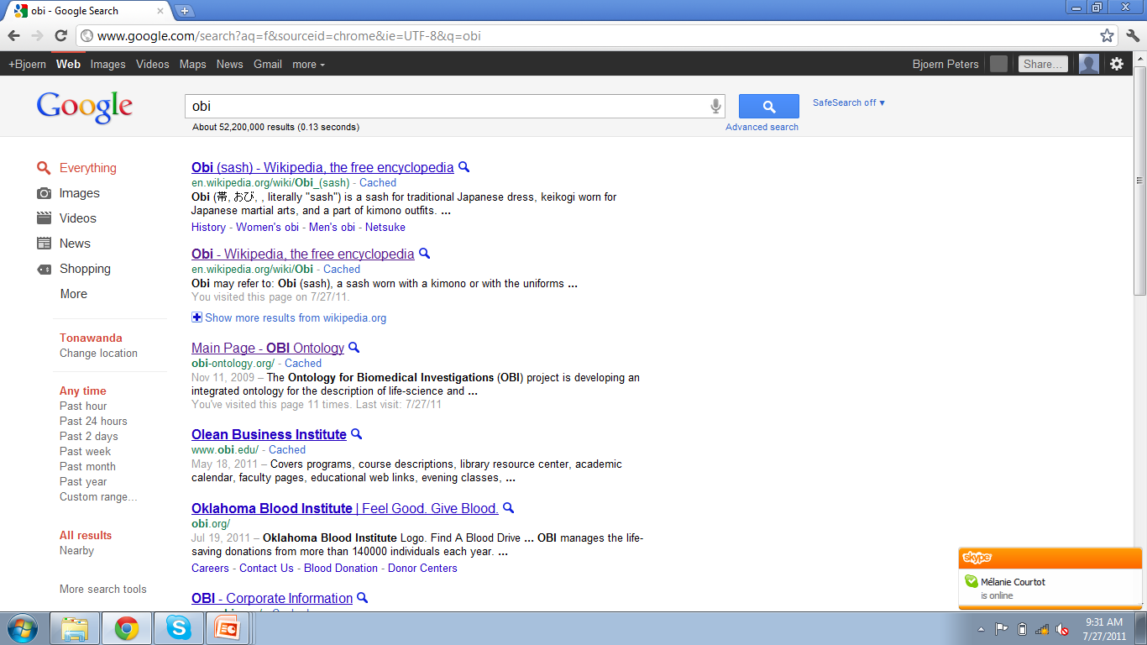

Slide 3
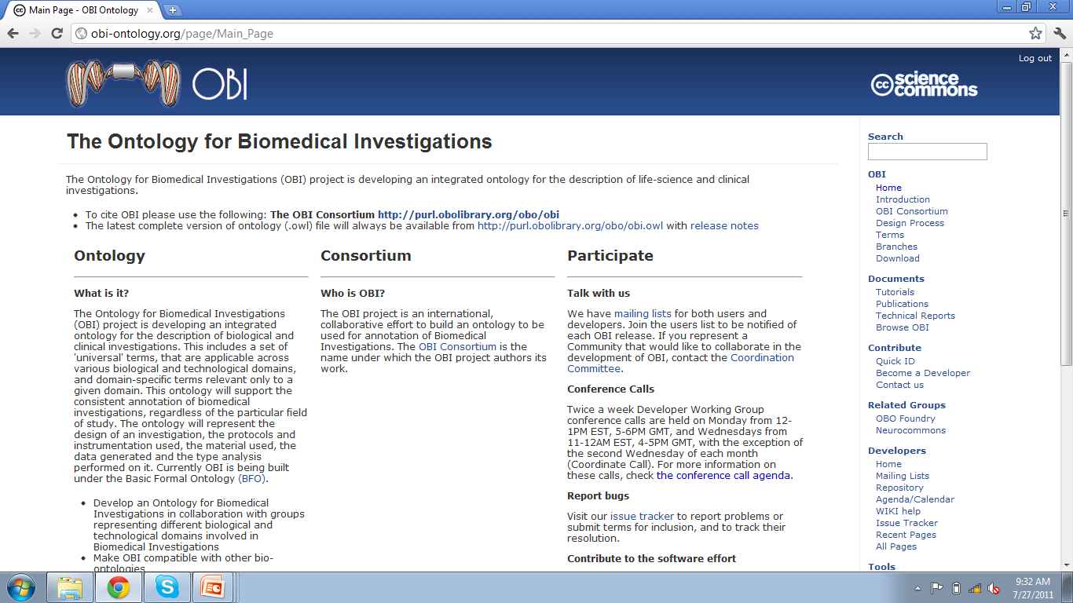

Slide 4
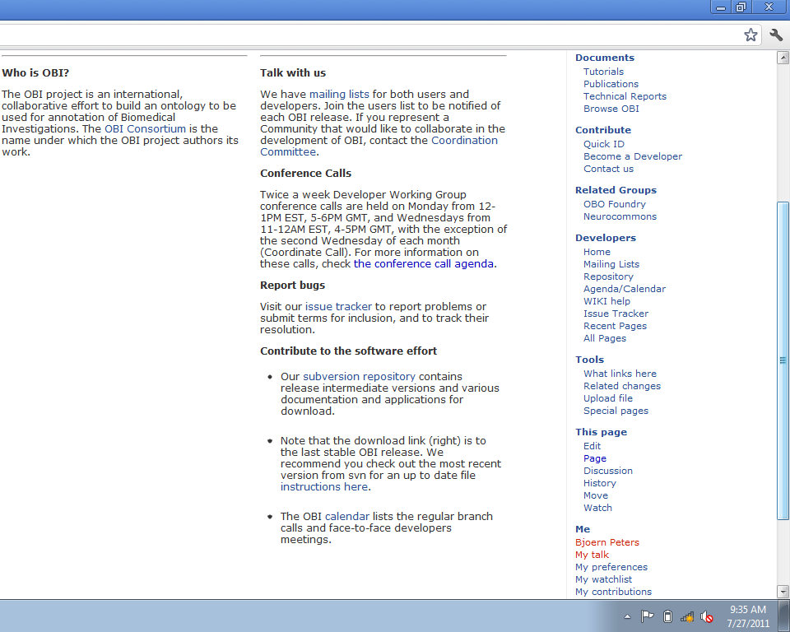

Slide 5
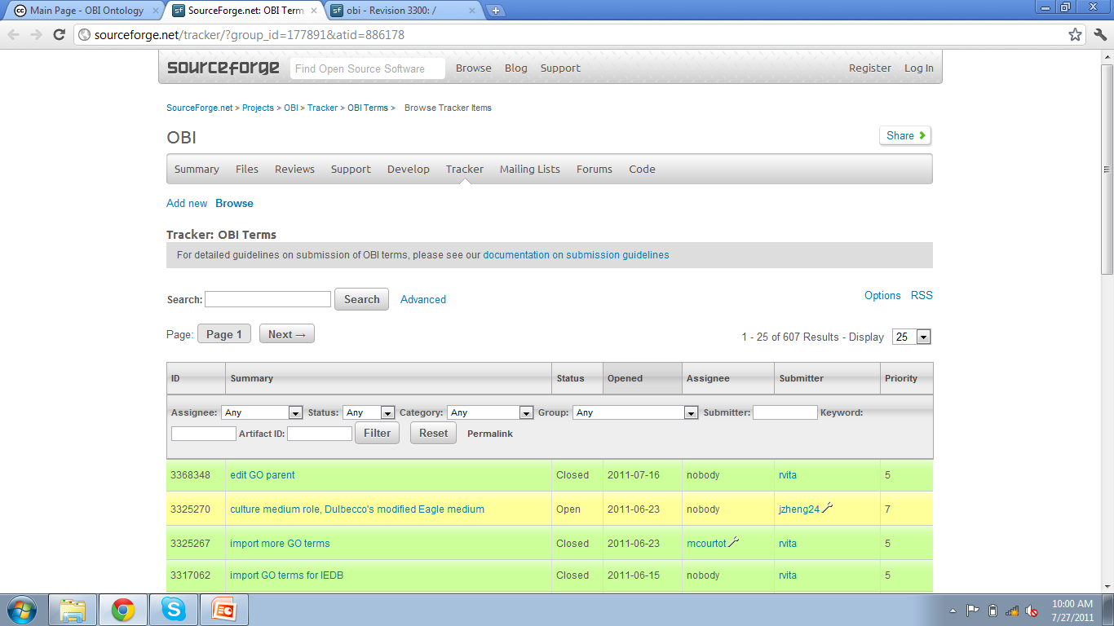

Slide 6
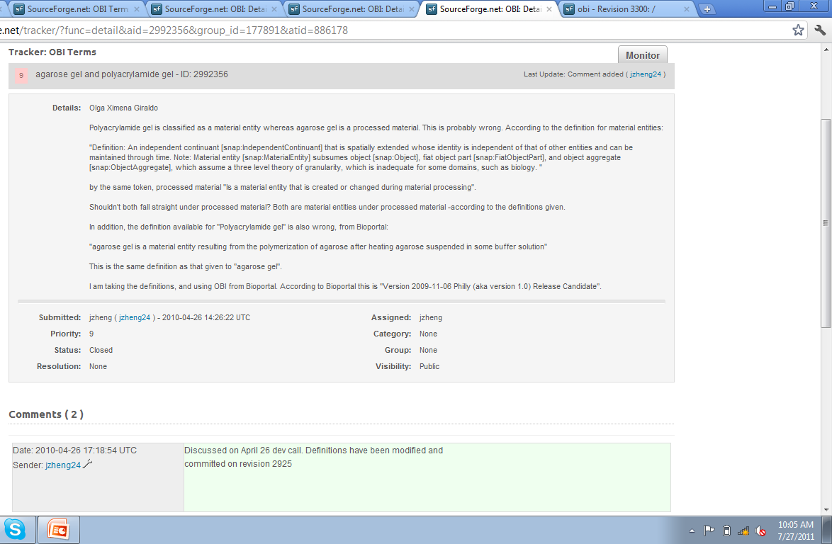

Slide 7
Better: Join OBI! speeds up and improves response
Join a call. Fine to be involved for a limited time. You might even enjoy it.

Slide 8
Editing OBI
Check out OBI via svn
Open in Protégé 4.1
Edit – annotations (metadata) and logical definition
Reason to check if you broke something
Check modified version in, including description of changes

Slide 9
Requests?

Slide 10
Summary
There are multiple ways to enhance OBI
Submit to tracker
Follow up on mailing list
Join OBI
Modifying OBI requires
Textual definition + metadata
Placement in hierarchy
Logical definition

